Slide 1

ACCESSING JUSTICE IN 2020
AND BEYOND
Hon. Edwina G. Mendelson
Deputy Chief Administrative Judge for Justice Initiatives

Slide 2






OFFICE FOR JUSTICE INITIATIVES (OJI)
To ensure meaningful access to justice for those passing through the doors of every New York State Court regardless of income, background or special need.
PROGRAMS
COURT ACCESS
COMMUNITY OUTREACH
FAMILY, JUVENILE, ADOLESCENT & EMERGING ADULT JUSTICE
nycourts.gov/OJI

Slide 3




COURT ACCESS
Access to Justice
What is Access to Justice?
What does it mean to you?
Why does Access to Justice matter?
Adhering to Principles of
Leads to
Ensuring fulfillment of legal rights
Fairness and trustworthiness
Procedural Justice
Court Efficiency
Better Outcomes
nycourts.gov/OJI

Slide 4
COURT ACCESS
Access to Justice
Chief Judge Janet DiFiore: “[Over] the last decade, New York State has become the undisputed leader in the nation when it comes to meeting the civil legal needs of low-income people, and we will continue to work to maintain our prominence and excellence in the field.”
-2020 Civil Legal Services Hearing
OJI has programmatic oversight over the Judicial Civil Legal Services program that enables more New Yorkers to meet their legal needs, resulting in better outcomes in the essentials of life for themselves, their families and their communities.
nycourts.gov/OJI

Slide 5
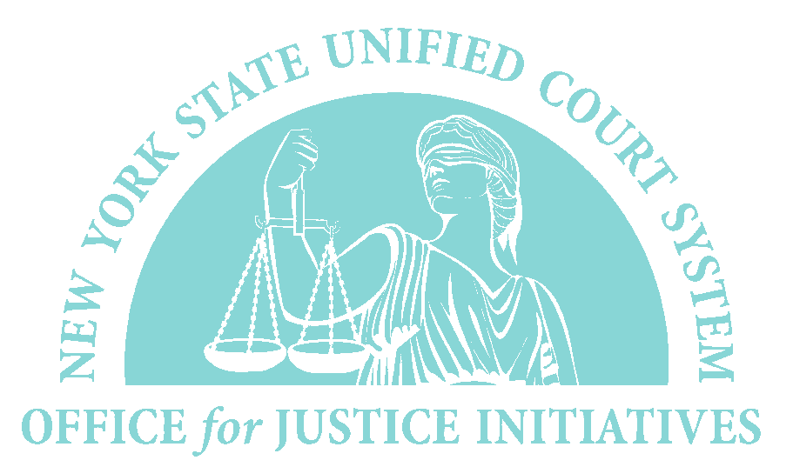

COURT ACCESS
In March COVID-19 forced courts throughout New York State to reconsider how people navigate our court system.
OJI temporarily suspended all court-based volunteer programs as of March 11, 2020. Help Centers were closed statewide on March 17.
nycourts.gov/OJI

Slide 6
COURT ACCESS
In March COVID-19 forced courts throughout New York State to reconsider how people navigate our court system.
nycourts.gov/OJI

Slide 7
COURT ACCESS
In March COVID-19 forced courts throughout New York State to reconsider how people navigate our court system.
4:11 🗪
◢LTE ▮97%
(800) CourtNY
Ask A Law Librarian
LawHelp.org
❮
nycourts.gov/OJI

Slide 8

COURT ACCESS
In the best of times, court users (especially those who are unrepresented) appearing in court often face challenges:
Intimidated by the court
Difficulty getting around the courthouse
Lack of legal knowledge and procedure
Low reading comprehension
Low English proficiency
nycourts.gov/OJI

Slide 9


COURT ACCESS
When engaging with unrepresented court users remember to incorporate trauma informed practices by being mindful of:
The Environment
The Circumstance
nycourts.gov/OJI

Slide 10
COURT ACCESS
Now, in addition, these court users face an entirely new set of challenges:
Lack of access to and familiarity with necessary technology
Difficulty understanding administrative orders and the definition of essential matters
Difficulty keeping up with rapidly evolving court-based procedures
nycourts.gov/OJI

Slide 11



COURT ACCESS
To begin addressing these new challenges, OJI developed:
UNREPRESENTED COURT USERS REPORT
KNOW BEFORE YOU GO
VIRTUAL RESOURCES AND REMOTE ACCESS PROGRAMS
nycourts.gov/OJI

Slide 12
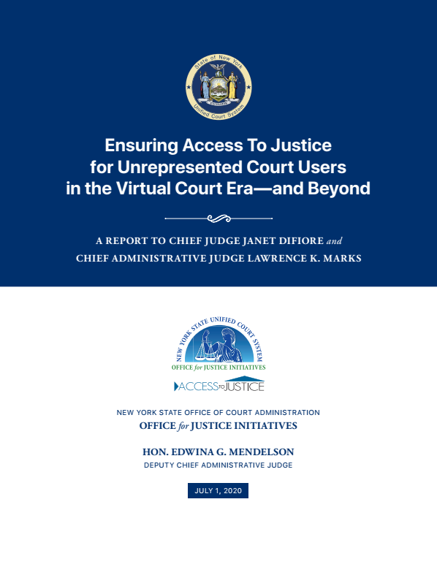
UNREPRESENTED COURT USERS REPORT
Chief Judge DiFiore and Chief Administrative Judge Marks appointed Judge Mendelson to lead a working group to consider and develop strategies for promoting access to our virtual courts for unrepresented court users.
OJI partnered with…
DCAJs Caruso & Silver
The NYC Self Represented
Committee
Administrative Judges and District Executives Outside NYC
Multidisciplinary stakeholder groups
nycourts.gov/OJI

Slide 13
UNREPRESENTED COURT USERS REPORT
Chief Judge DiFiore and Chief Administrative Judge Marks appointed Judge Mendelson to lead a working group to consider and develop strategies for promoting access to our virtual courts for unrepresented court users.
The Report…
Highlights efforts by jurisdictions across the state to promote access to virtual courts
Identifies UCS efforts to maintain access to justice
Gives recommendations for how best to move forward
nycourts.gov/OJI

Slide 14
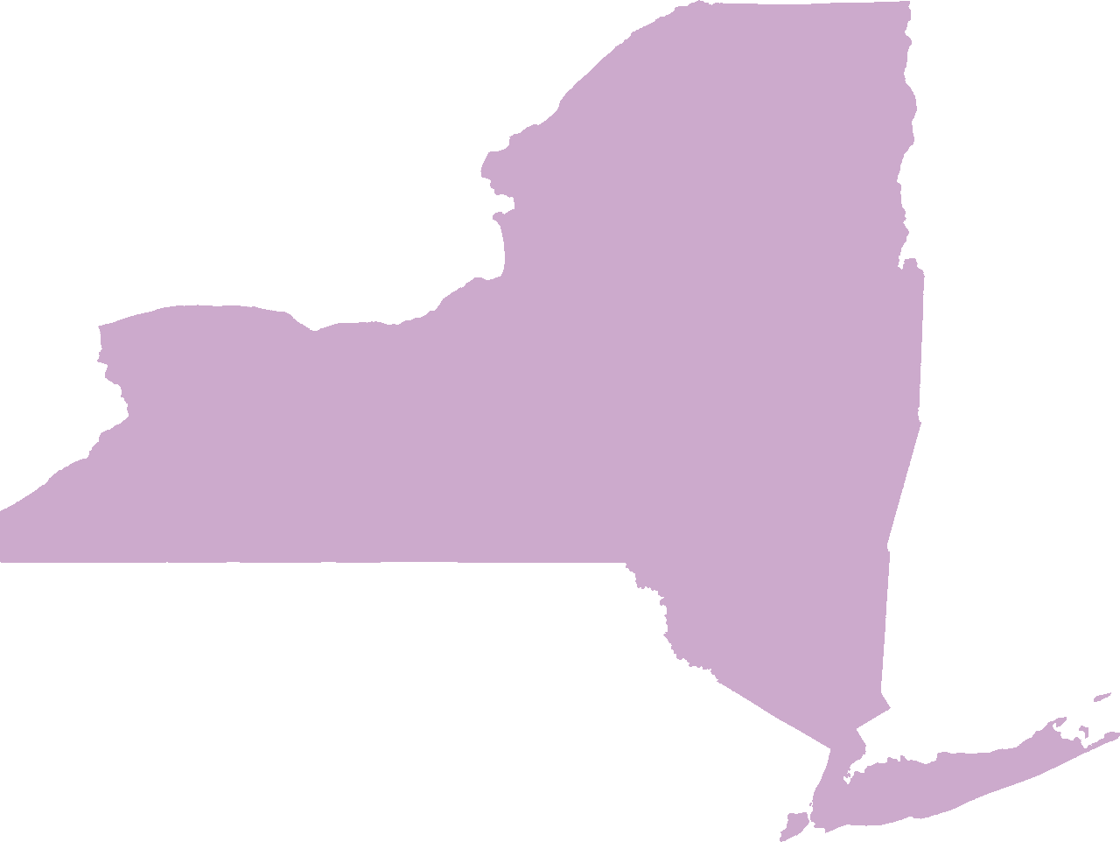
A2J INNOVATION AROUND NYS
Statewide
Division of Technology mailed informational notices to litigants with pending cases to advise about future court appearances.
4th Judicial District
Established an in-person virtual “kiosk” at each open courthouse location that permits public entry to the courthouse to seek the assistance of a clerk or to file a petition without having to physically interact at the court’s petition window.
7th Judicial District
Established a Virtual Help Center through the Volunteer Legal Services Project (VLSP). Using live chat capability, the Virtual Help Center has pro bono attorneys and VLSP staff available online to answer legal information questions, provide court documents online, and complete virtual notarization requests.
Richmond County Surrogate’s Court
Created YouTube videos to assist with guardianship proceedings, as well as form templates and plain language informational sheets for unrepresented court users.
nycourts.gov/OJI

Slide 15

A2J INNOVATION AROUND NYS
Statewide
Division of Technology mailed informational notices to litigants with pending cases to advise about future court appearances.
4th Judicial District
Established an in-person virtual “kiosk” at each open courthouse location that permits public entry to the courthouse to seek the assistance of a clerk or to file a petition without having to physically interact at the court’s petition window.
7th Judicial District
Established a Virtual Help Center through the Volunteer Legal Services Project (VLSP). Using live chat capability, the Virtual Help Center has pro bono attorneys and VLSP staff available online to answer legal information questions, provide court documents online, and complete virtual notarization requests.
Richmond County Surrogate’s Court
Created YouTube videos to assist with guardianship proceedings, as well as form templates and plain language informational sheets for unrepresented court users.
nycourts.gov/OJI

Slide 16

A2J INNOVATION AROUND NYS
Statewide
Division of Technology mailed informational notices to litigants with pending cases to advise about future court appearances.
4th Judicial District
Established an in-person virtual “kiosk” at each open courthouse location that permits public entry to the courthouse to seek the assistance of a clerk or to file a petition without having to physically interact at the court’s petition window.
7th Judicial District
Established a Virtual Help Center through the Volunteer Legal Services Project (VLSP). Using live chat capability, the Virtual Help Center has pro bono attorneys and VLSP staff available online to answer legal information questions, provide court documents online, and complete virtual notarization requests.
Richmond County Surrogate’s Court
Created YouTube videos to assist with guardianship proceedings, as well as form templates and plain language informational sheets for unrepresented court users.
nycourts.gov/OJI

Slide 17
A2J INNOVATION AROUND NYS
Statewide
Division of Technology mailed informational notices to litigants with pending cases to advise about future court appearances.
4th Judicial District
Established an in-person virtual “kiosk” at each open courthouse location that permits public entry to the courthouse to seek the assistance of a clerk or to file a petition without having to physically interact at the court’s petition window.
7th Judicial District
Established a Virtual Help Center through the Volunteer Legal Services Project (VLSP). Using live chat capability, the Virtual Help Center has pro bono attorneys and VLSP staff available online to answer legal information questions, provide court documents online, and complete virtual notarization requests.
Richmond County Surrogate’s Court
Created YouTube videos to assist with guardianship proceedings, as well as form templates and plain language informational sheets for unrepresented court users.
nycourts.gov/OJI

Slide 18
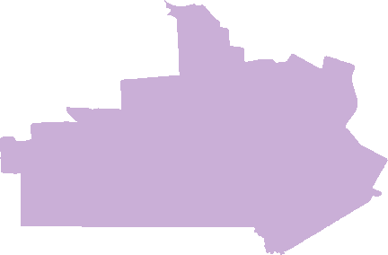
A2J INNOVATION AROUND NYS
6th Judicial District:
Providing portable, Wi-Fi enabled tablets for unrepresented court users to participate in court proceedings.
nycourts.gov/OJI

Slide 19

A2J INNOVATION AROUND NYS
6th Judicial District:
Providing portable, Wi-Fi enabled tablets for unrepresented court users to participate in court proceedings.
8th Judicial District
Created Family Court Help Desks, staffed by Volunteer Lawyers Project. Help Desk volunteers assist court users make court appearances, schedule appointments, or fill out paperwork.
nycourts.gov/OJI

Slide 20

A2J INNOVATION AROUND NYS
6th Judicial District:
Providing portable, Wi-Fi enabled tablets for unrepresented court users to participate in court proceedings.
8th Judicial District
Created Family Court Help Desks, staffed by Volunteer Lawyers Project. Help Desk volunteers assist court users make court appearances, schedule appointments, or fill out paperwork.
9th Judicial District
Launched the Faith-Based Community Kiosk program, which provides a safe and private area within houses of worship and religious locations for court users to access the court system and get referrals to legal representation.
nycourts.gov/OJI

Slide 21

A2J INNOVATION AROUND NYS
6th Judicial District:
Providing portable, Wi-Fi enabled tablets for unrepresented court users to participate in court proceedings.
8th Judicial District
Created Family Court Help Desks, staffed by Volunteer Lawyers Project. Help Desk volunteers assist court users make court appearances, schedule appointments, or fill out paperwork.
9th Judicial District
Launched the Faith-Based Community Kiosk program, which provides a safe and private area within houses of worship and religious locations for court users to access the court system and get referrals to legal representation.
10th Judicial District
Created an extensive Resource Guide, providing listings and contact information for many different services in a variety of areas. The Resource Guide is available in both hard copy and on the court’s website.
nycourts.gov/OJI

Slide 22
UNREPRESENTED COURT USERS REPORT
Chief Judge DiFiore and Chief Administrative Judge Marks appointed Judge Mendelson to lead a working group to consider and develop strategies for promoting access to our virtual courts for unrepresented court users.
Recommendations Included…
Developing informational materials describing the types of legal matters courts are addressing, and hearing in person.
Creating a brief, plain language online tutorial on how to access court matters virtually.
Regularly updating the CourtHelp plain language website.
nycourts.gov/OJI

Slide 23
UNREPRESENTED COURT USERS REPORT
Chief Judge DiFiore and Chief Administrative Judge Marks appointed Judge Mendelson to lead a working group to consider and develop strategies for promoting access to our virtual courts for unrepresented court users.
Implementation
OJI has begun implementing recommendations:
Know Before You Go
Public Access Terminal Court Hubs
Brooklyn Public Library Livestreams
Virtual Resource Center
Family Courts in a Virtual Age Roundtable
Accessing Justice During COVID-19 Webinar
nycourts.gov/OJI

Slide 24
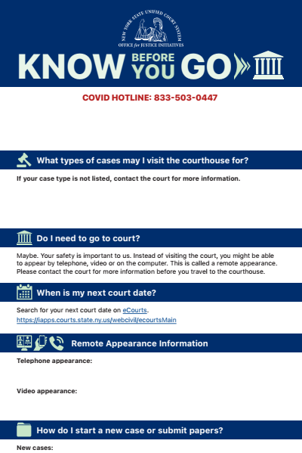
KNOW BEFORE YOU GO
OJI created a plain language template for each Judicial District to convey necessary information to potential court users.
Covid-19 Hotline phone number
Court location and contact info
Case types being heard in person
How to file or submit documents
Remote appearance information
Where to find free legal information
Interpreters/ADA accommodations
Courthouse safety procedures
4:11 🗪
◢LTE ▮97%
❮
nycourts.gov/OJI

Slide 25
Public Access Terminal Court Hubs
OJI, in collaboration with the Center for Court Innovation, will be piloting the Public Access Terminal Court Hubs (PATCH) program in the Brownsville Community Justice Center, providing a convenient, private and sanitary location for the local community to access the courts without traveling or increasing courthouse foot traffic.
Case Types
Civil Court:
  HP Action
  Consumer Debt matters
  Eviction
Family Court:
  Orders of Protection
  Emergency matters
Brownsville Community Justice Center
Belmont ^{Av}
nycourts.gov/OJI

Slide 26
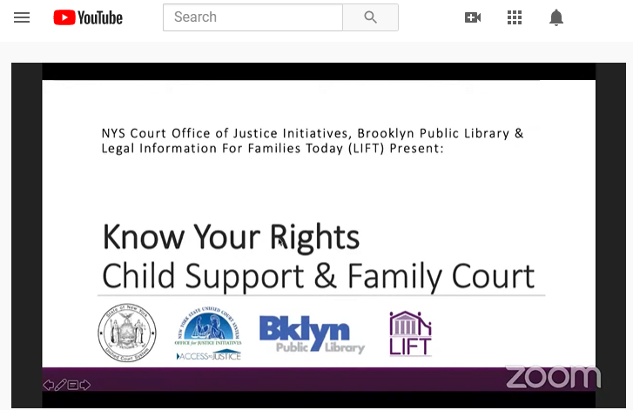
BROOKLYN PUBLIC LIBRARY LIVESTREAMS
Monthly live-streamed “Know your Rights/Court Resources” presentations entitled First Thursday Co-hosted by OJI appearing on the Brooklyn Public Library’s YouTube Channel: youtube.com/user/BPLvideos
Completed Programs
Tenants Rights
Child Support
Upcoming Program
January 7th
  Surrogates Court: When Someone Dies
nycourts.gov/OJI

Slide 27
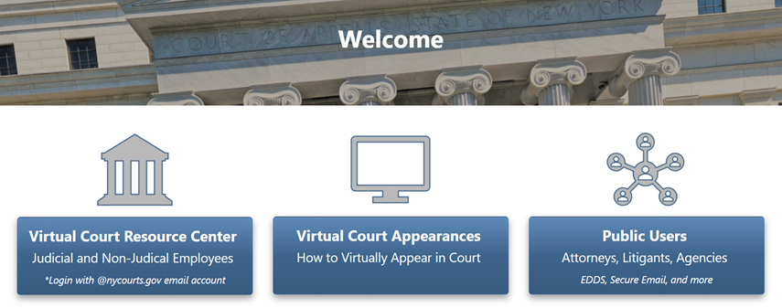
VIRTUAL RESOURCE CENTER
PORTAL.NYCOURTS.GOV
Developed and maintained by the department of technology, the virtual resource center offers information and virtual tools for court users, attorneys, judges and non-judicial court staff.
nycourts.gov/OJI

Slide 28
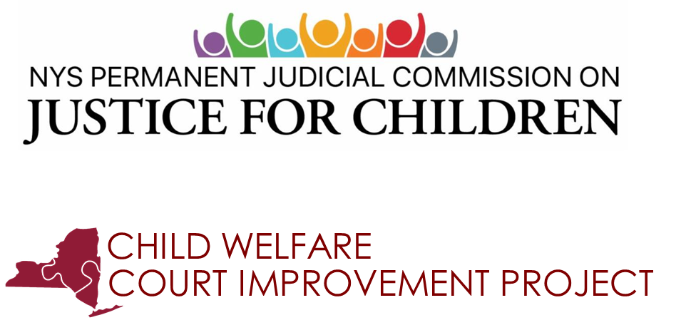
FAMILY COURTS IN THE VIRTUAL AGE
VIRTUAL ROUNDTABLE
This live virtual roundtable discussion addressed the Family Courts’ reaction to the pandemic and analyzed the implications, both now and in the future, for virtual representation.
nycourts.gov/OJI

Slide 29
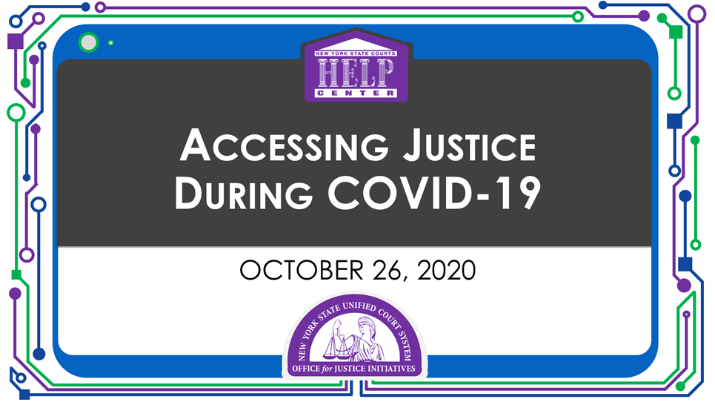
ACCESSING JUSTICE DURING
COVID-19 WEBINAR
A free informational webinar for unrepresented court users produced for National Pro Bono Week, available at: http://wowza.nycourts.gov/vod/wowzaplayer.php?source=oca&video=2020-AccessingJusticeDuringCovid-19.mp4
Divorce
Name changes
Small estates
CourtHelp
DIY (Do-It-Yourself) Form Programs
nycourts.gov/OJI

Slide 30


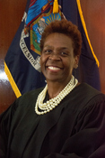
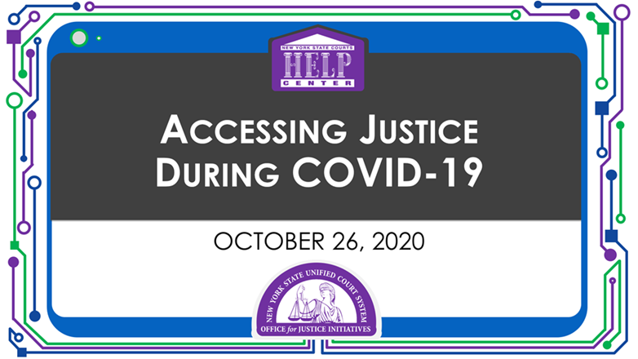





OJI WEBSITE
🔒 │ www.nycourts.gov
/OJI
Home
Overview
About Us
Please be advised that the New York State Unified Court System Office for Justice Initiatives has temporarily suspended all court-based volunteer lawyer programs.
We look forward to resuming all programs at the appropriate time.
Administration
Access To Justice Program
Deputy Chief Administrative Judge for Justice Initiatives
Raise The Age
Find free LEGAL ASSISTANCE during the Coronavirus crisis by phone and online
Child Permanency Mediation
Hon. Edwina G. Mendelson
Chief of Staff
Michelle Smith, Esq.
New and easy to follow instructions for making phone and video court appearance are here:
Video | PowerPoint | Transcript
Juvenile Justice
Permanent Commission on Access to Justice
Welcome
The New York State Unified Court System’s Office for Justice Initiatives led by Honorable Edwina G. Mendelson, Deputy Chief Administrative Judge for Justice Initiatives, is charged with directing the New York State Courts Access to Justice Program. The Office for Justice Initiatives (OJI) also oversees child welfare and juvenile and adolescent justice initiatives, including implementation of legislation raising the age of criminal responsibility in New York (commonly known as the “Raise the Age” law). The Office for Justice Initiatives works closely with the Permanent Commission on Access to Justice, as well as with the Advisory Committee on Access for People with Disabilities, the Center for Court Innovation (CCI), the Division of Technology, the Grants Office, the Office of Language Access, Office of Legal Information and law schools.
What’s New
Language Access & Interpreters
Accessing Justice During Covid-19
Video | Transcript
Family Court Representation in the Virtual Age
Video | Transcript
Family Court in the Virtual Age
Video | Transcript
Accessibility (ADA)
Alternative Dispute Resolution
Grants & Contracts
Pro Bono
Events & News
Contact Us

Slide 31
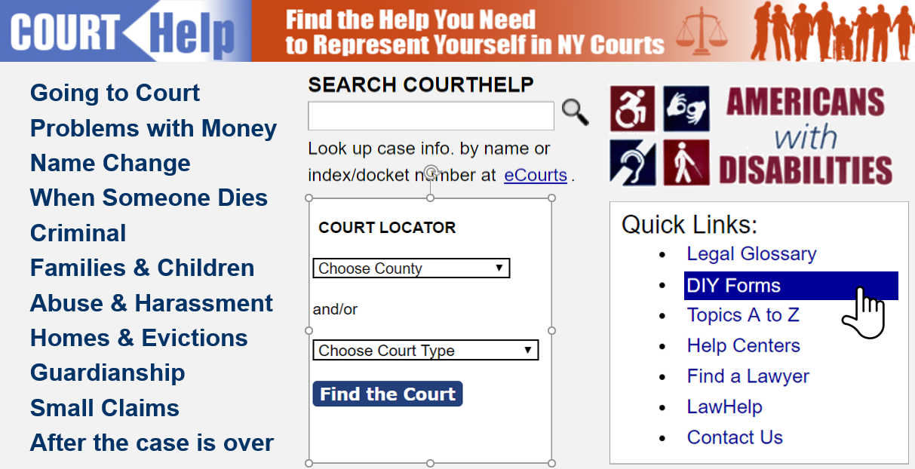
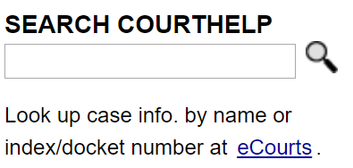

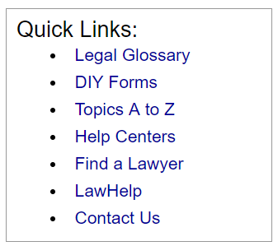
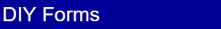
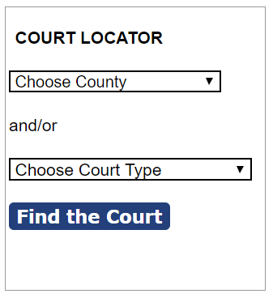

OJI WEBSITE
🔒 │ www.nycourts.gov
/courthelp
We are committed to providing you with the most accurate information!
CourtHelp is being updated to reflect changes in the law, issues related to COVID-19 and other legal developments.
You may contact the Public Access Law Library in your county ora Court Help Center for further assistance.
Welcome! CourtHelp can help you when you don’t have a lawyer
Going to Court
Problems with Money
Name Change
When Someone Dies
Criminal
Families & Children
Abuse & Harassment
Homes & Evictions
Guardianship
Small Claims
After the case is over

Slide 32


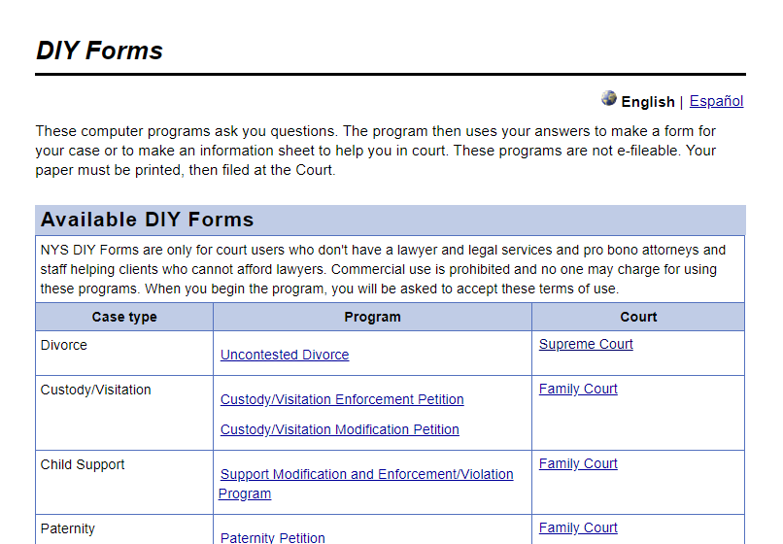
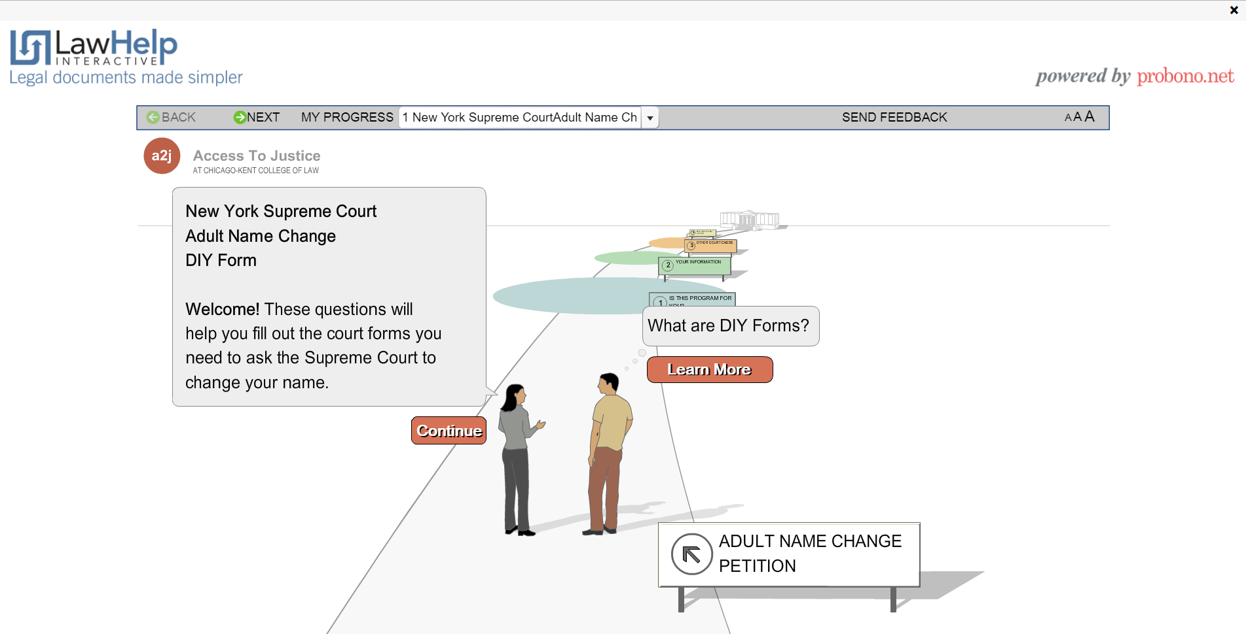
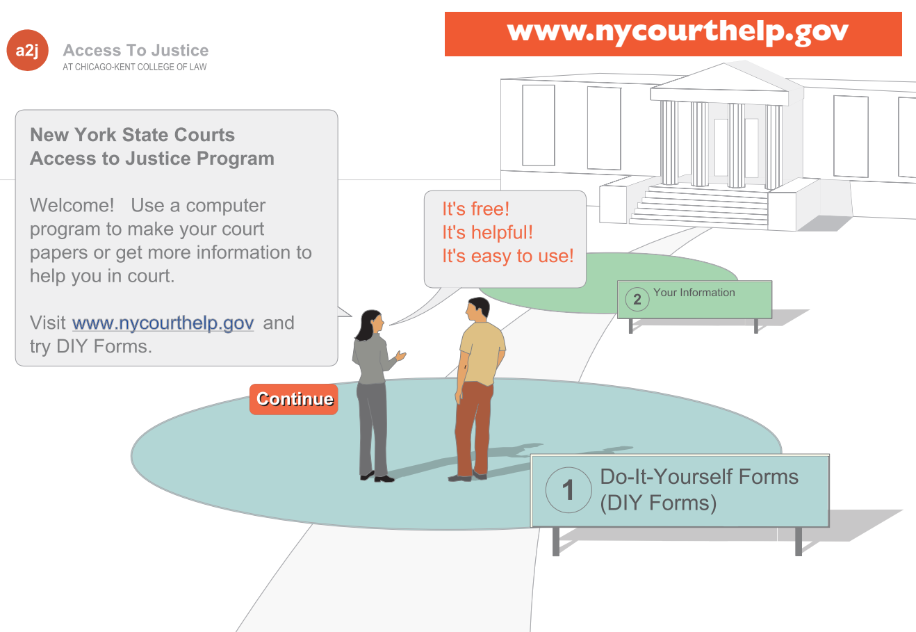
🔒 │ www.nycourts.gov
/courthelp
/DIY
D
I
Y
DIY (Do-It-Yourself) Program Forms guide users through the process of making the papers they need to file in court and provide step-by-step instructions:
Family Court
Housing/District, City Town & Village Courts
Supreme Court
Surrogates Court

Slide 33
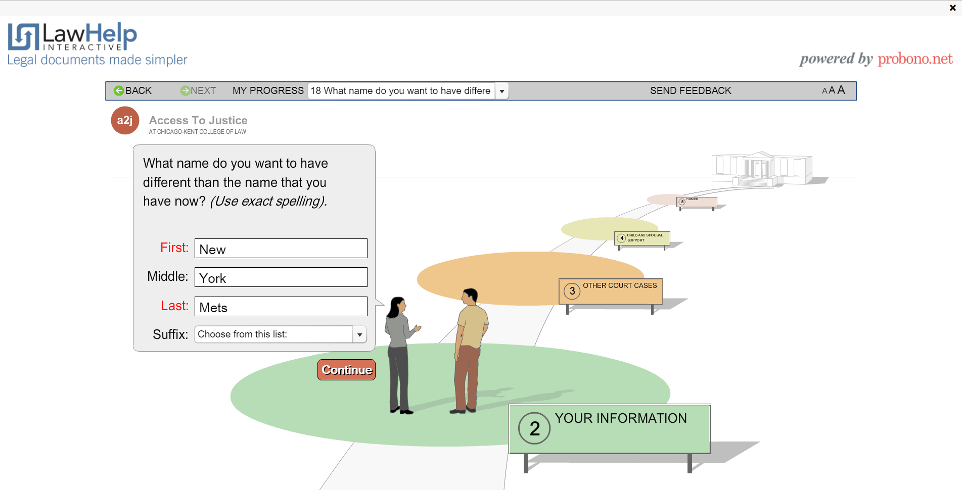
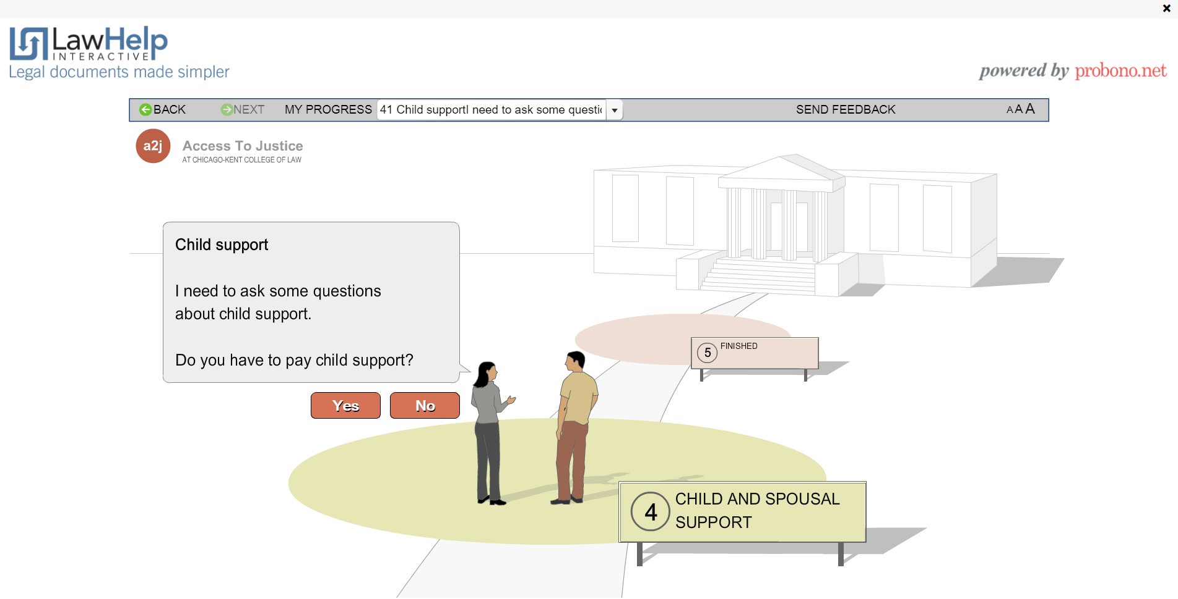
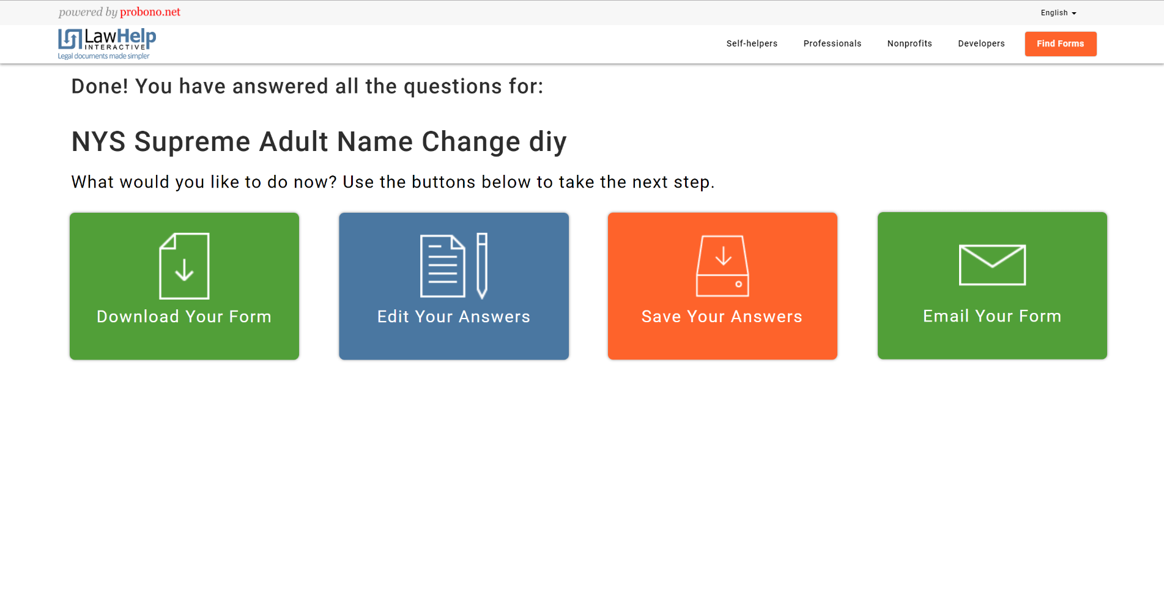
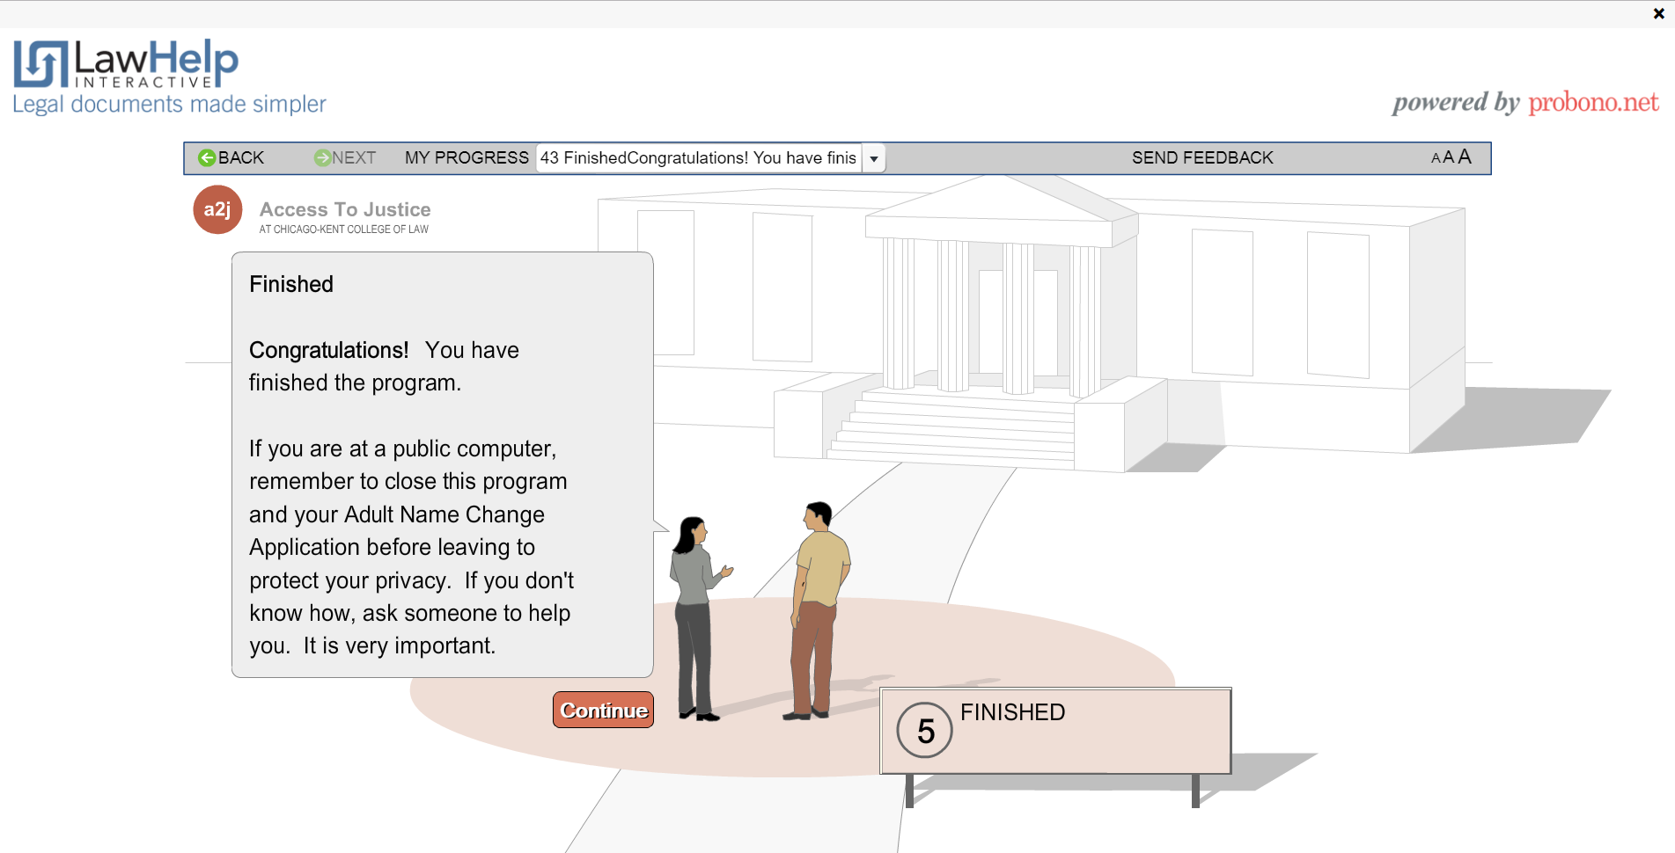
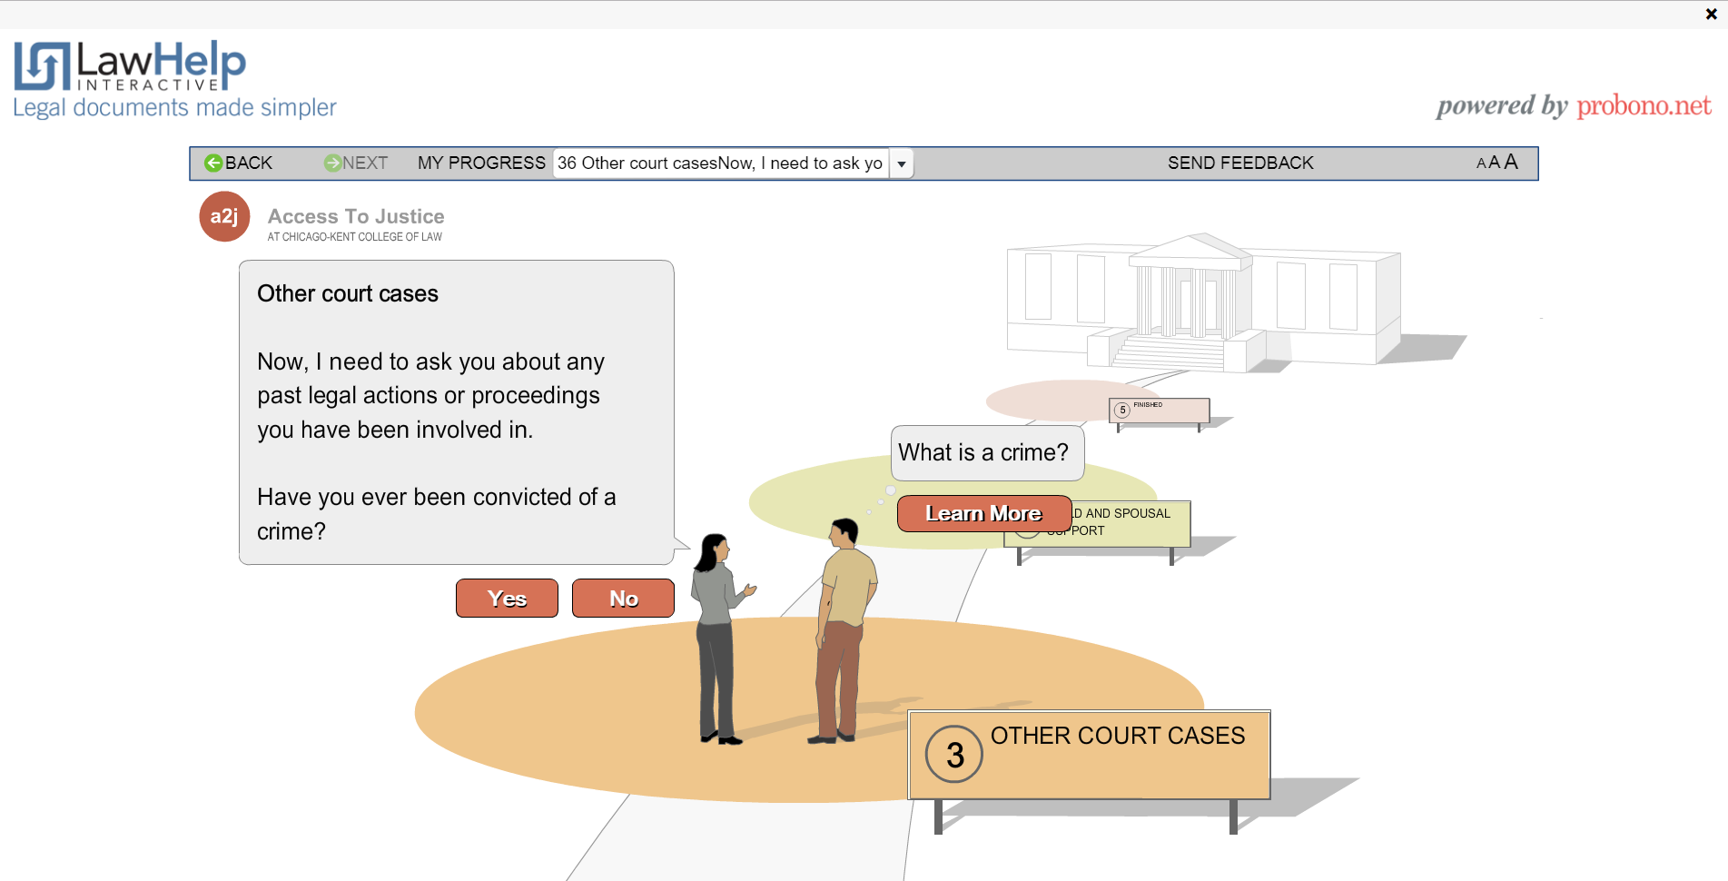
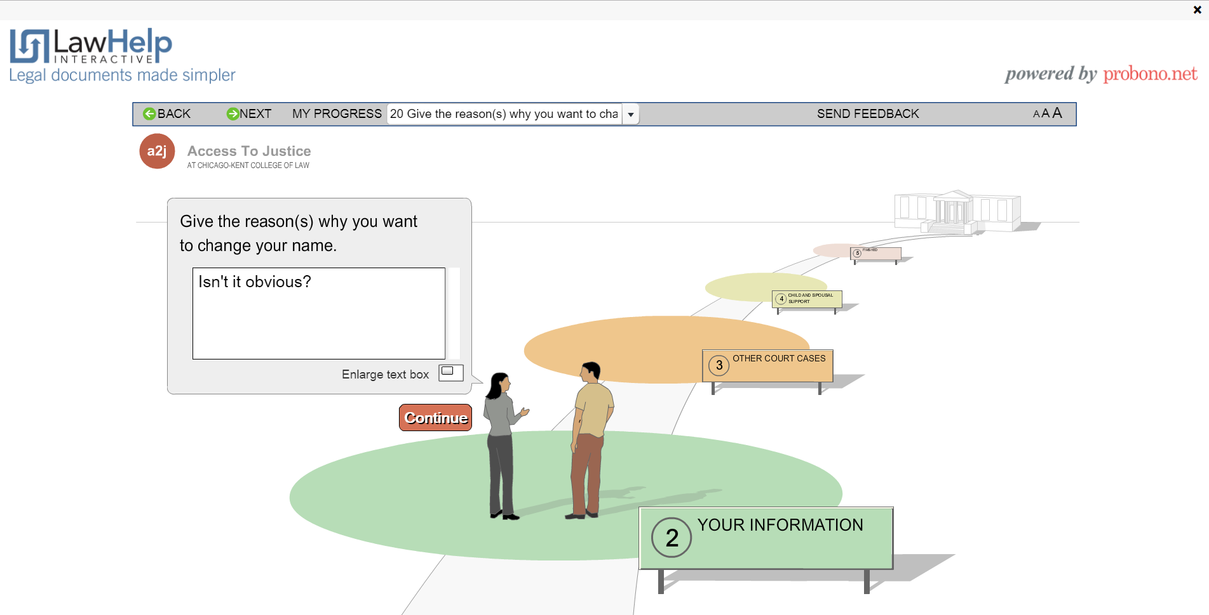
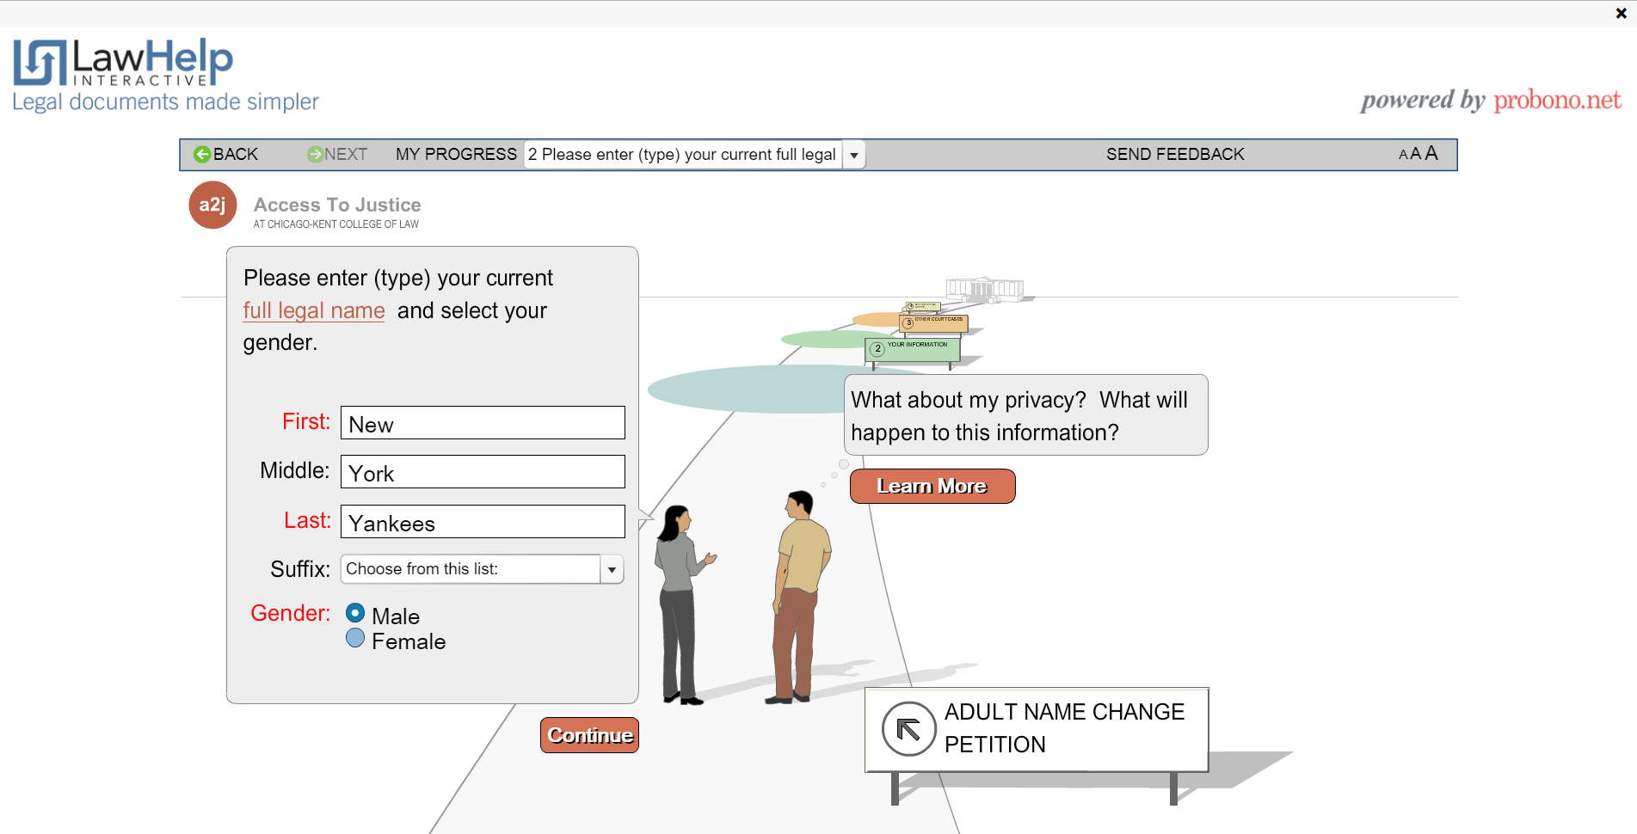

🔒 │ www.nycourts.gov
/courthelp
/DIY
/nameChange.shtml
D
I
Y
DIY

Slide 34
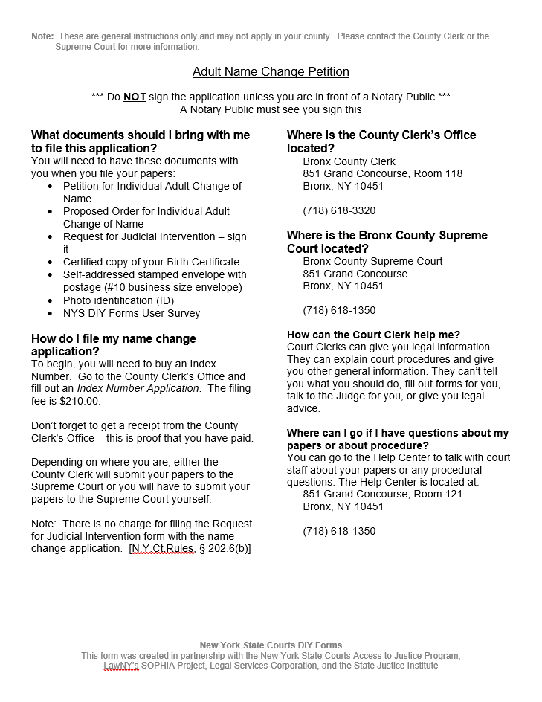
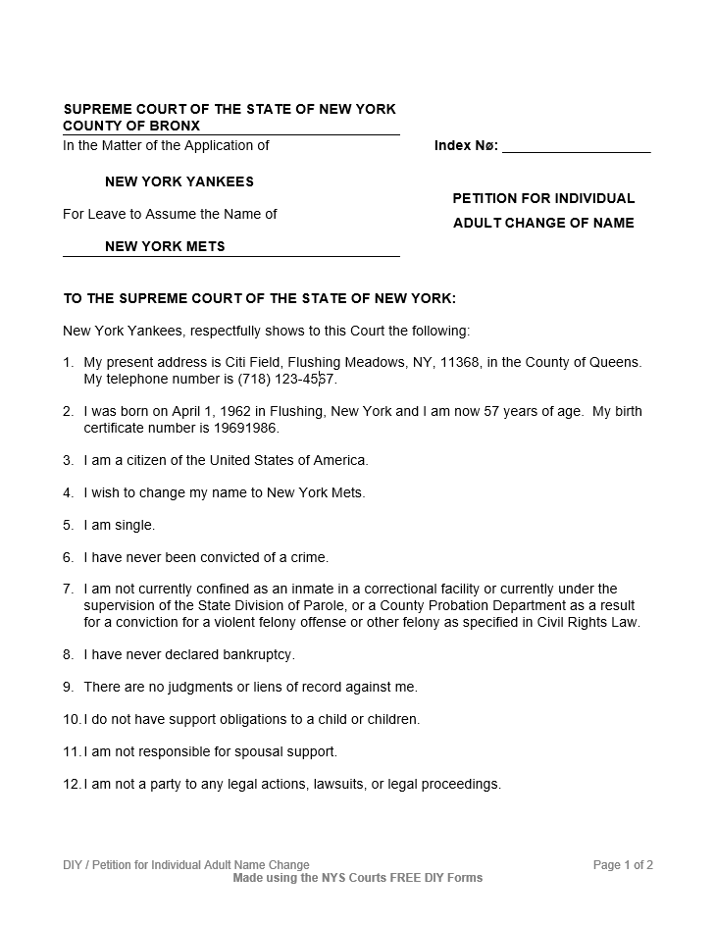
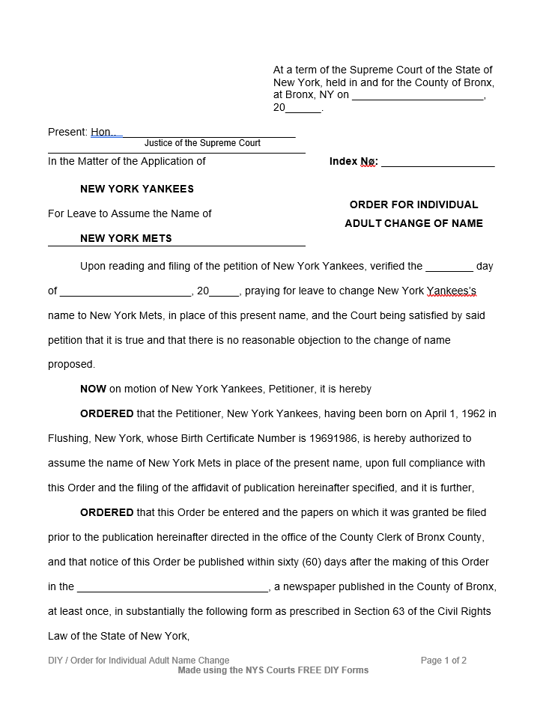
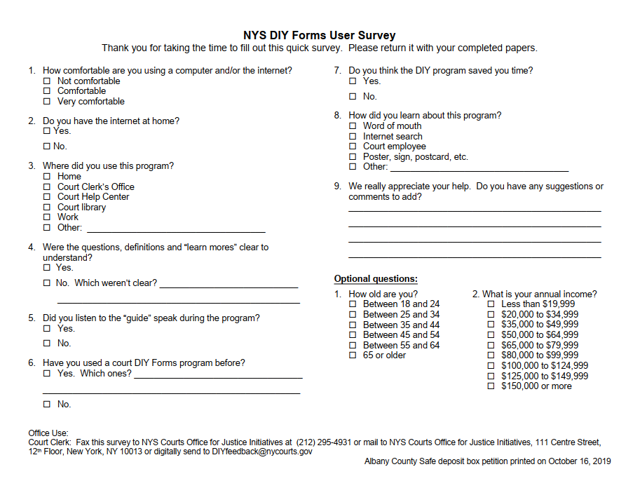



Filing Instructions
FILING OPTIONS INCLUDE
D
I
Y
Petition
In Person
By Mail
Electronic Document Delivery System (EDDS) &
NYS Courts Electronic Filing (NYSCEF)
Websites that, depending on case type and status, offer electronic delivery of documents. Programs were expanded in recent months due to COVID-19. EDDS is only available for pending cases where NYSCEF is not available.
Order
User Survey
&

Slide 35
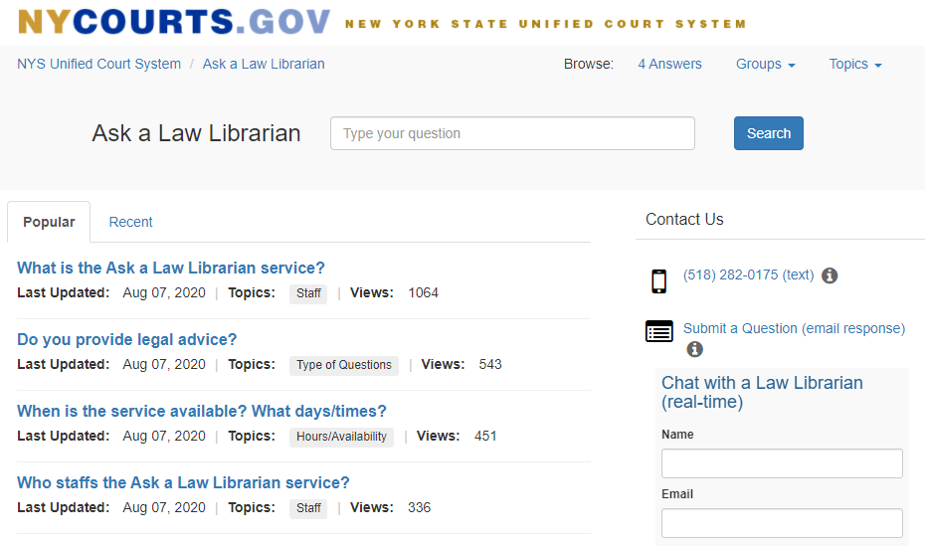
ASK A LAW LIBRARIAN
ASK A LAW LIBRARIAN
The Ask a Law Librarian service, staffed by NYS UCS law library personnel, offers remote legal reference to the general public and is intended to answer legal reference questions posed by the public.
Real-time chat with a Law Librarian
1000+ inquiries
Askalawlibrarian.nycourts.gov

Slide 36
COURT ACCESS
OJI offers programs and services:
Self-Help Tools
    OJI Website
    CourtHelp
    Do-It-Yourself Forms (DIY)
    Ask A Law Librarian
Court Help Centers
Court-based Pro Bono Programs
Access for Vulnerable Populations/Litigants with Diverse Needs
Plain Language Initiative
ASK A LAW LIBRARIAN
nycourts.gov/OJI

Slide 37



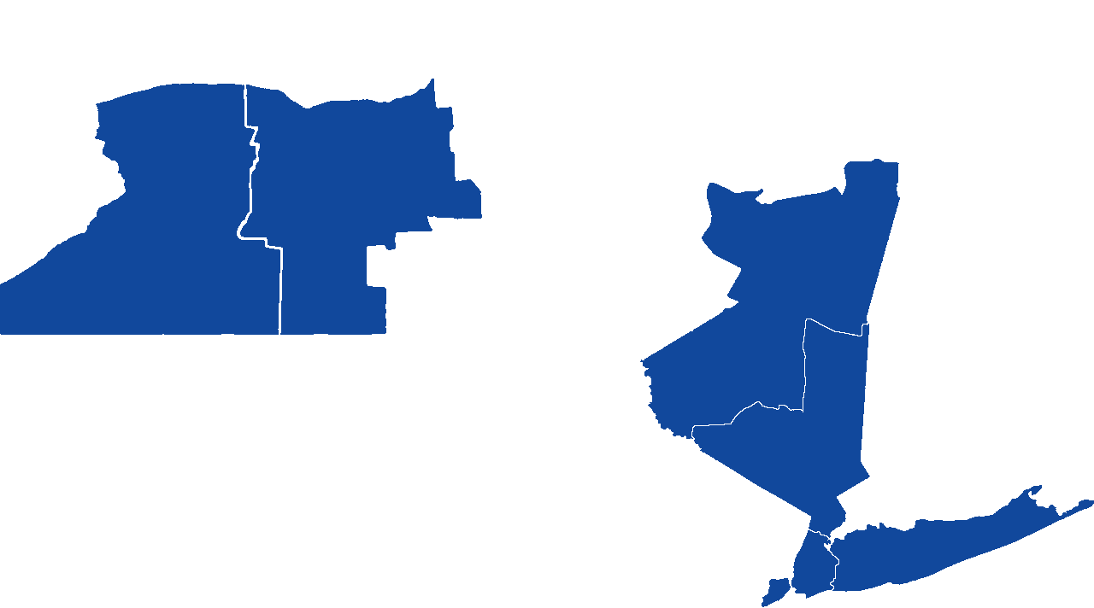




COURT HELP CENTERS
OJI coordinates Help Centers throughout New York State
The number of court users
assisted has grown from
Free/No income screening
Neutral
One-on-one consultations with a court employee
Written explanatory materials
Court forms
Referrals
COURT-BASED PRO BONO PROGRAMS
Following the suspension of in-person operations due to COVID-19, Help Centers across the state transitioned to offering virtual services, and new Help Centers cropped up throughout the state.
211K
The Court users were assisted in
nycourts.gov/CourtHelp/GoingToCourt/helpcenters

Slide 38
COURT HELP CENTERS
Free/No income screening
Neutral
One-on-one consultations with a court employee
Written explanatory materials
Court forms
Referrals
PRO BONO PROGRAMS
nycourts.gov/CourtHelp/GoingToCourt/helpcenters

Slide 39


PRO BONO PROGRAMS
Lack of access to legal assistance deeply hurts our communities and adversely impacts the functioning and operations of our courts.
I Can Help!
OJI operates and supports several court-based pro bono programs providing limited scope advice or representation to unrepresented court users:
Volunteer Attorney Programs
Law Students Programs
Attorney Emeritus Program
Court Help Centers can connect unrepresented litigants to Pro Bono Programs
Legal Information for Families Today (LIFT) Family Court programs
If your jurisdiction does not have a Court Help Center or Pro Bono Program, OJI can help facilitate the development of them
I need legal advice!
What do I say to the Judge?
Pro Bono Programs are in:
Family Court
Supreme Court
Housing & Civil Court
Surrogates Court
nycourts.gov/attorneys/volunteer

Slide 40
PRO BONO PROGRAMS
OJI, UCS, and Bar Associations across the state are stepping up to provide free legal services to court users
  OJI
  Developing new virtual Pro Bono attorney and law student programs to better serve unrepresented court users in the current environment.
  Volunteer Lawyer Networks
  Bar Associations are developing networks providing free legal representation to court users in need.
  Pro Bono Network & COVID-19 Recovery Task Force
  Chief Judge DiFiore in partnership with the New York State Bar Association.
Lack of access to legal assistance deeply hurts our communities and adversely impacts the functioning and operations of our courts.
I Can Help!
OJI operates and supports several court-based pro bono programs providing limited scope advice or representation to unrepresented court users:
Volunteer Attorney Programs
Law Students Programs
Attorney Emeritus Program
Court Help Centers can connect unrepresented litigants to Pro Bono Programs
Legal Information for Families Today (LIFT) Family Court programs
If your jurisdiction does not have a Court Help Center or Pro Bono Program, OJI can help facilitate the development of them
I need legal advice!
What do I say to the Judge?
Pro Bono Programs are in:
Family Court
Supreme Court
Housing & Civil Court
Surrogates Court
  Pro Bono Network & COVID-19 Recovery Task Force
nycourts.gov/attorneys/volunteer

Slide 41
PRO BONO PROGRAMS
Pro Bono Network & COVID-19 Recovery Task Force
The mission of the Task Force is to facilitate the delivery of effective, comprehensive and efficient pro bono legal services, in urgent civil and criminal matters, to all New Yorkers in need during and in the wake of the COVID-19 pandemic and beyond.
Working Groups
Criminal Justice
Child Guardianship
Child Support
Domestic Violence
Diversity and Inclusion
Family Law
Healthcare
Housing
Immigration
Unemployment.
Training Portals
Unemployment Insurance
Surrogate’s Court
Housing
Current Programs
Unemployment Insurance
Surrogate’s Court
In conjunction with OJI, the Child Guardianship working group is connecting pro bono attorneys with families who are seeking custody and Guardianship of children whose adoptions have been disrupted due to COVID-19.
nycourts.gov/attorneys/volunteer

Slide 42
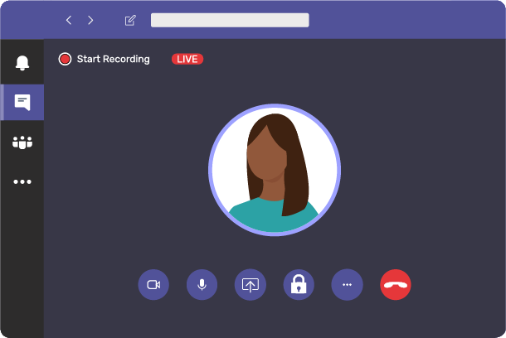
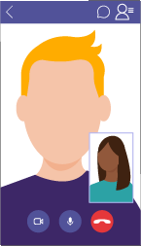
VIRTUAL UNCONTESTED DIVORCE PROJECT
Volunteer attorneys trained by OJI are providing free virtual assistance in preparing uncontested divorce papers for unrepresented litigants throughout all five boroughs of New York City in Partnership with CUNY Law and St. John Law School.
“Located” in
  Kings (CUNY)
  New York (Supreme Court Help Center)
  Queens (St. John’s)
Microsoft Teams
DIY Forms
Refers out cases involving children, distribution of assets or debts, and Orders of Protection
nycourts.gov/OJI

Slide 43





COURT USERS WITH DIVERSE NEEDS
Courts have a responsibility to address problems that interfere with a litigant’s ability to participate in proceedings.
Remote proceedings can help protect the safety of vulnerable populations and increase ease of access for impaired court users.
However, jurists must recognize that remote proceedings may also diminish their ability to notice subtle signs that may suggest a problem with veracity or overall comprehension.
More Obvious
Less Obvious
Mobility
Confusion
Limited English Proficiency
Older adult facing eviction despite sufficient income
A disengaged litigant
Invisible Disabilities
nycourts.gov/ip/nya2j/diverseneeds.shtml

Slide 44





COURT USERS WITH DIVERSE NEEDS
COVID-19 has exacerbated the fragility of vulnerable populations.
  The Unified Court System’s Office of the Statewide ADA Coordinator &
  The OCA Advisory Committee on Access for People with Disabilities
  Created a page on the court system’s public website, “Covid-19 and ADA Accommodations: Frequently Asked Questions,” with information on reasonable accommodations and remote court appearances.
  That page is available here: http://ww2.nycourts.gov/sites/default/files/document/files/2020-06/ADA%20COVID%2019%20FAQs%202020_0.pdf
  NYC Housing Court GAL Program
  GALs have continued providing services, and the GAL Program has kept GALs in the know on potential new advocacy challenges and the status of court operations. In July, the program partnered with the Weinberg Center to provide GALs with a virtual training entitled: “Housing Court, Older Adults and COVID-19: Detecting Elder Abuse Over the Phone.”
What are possible interventions?
NYC Housing Court
Reasonable Accommodations
Identify simple measures that may facilitate meaningful participation for a litigant, e.g.:
  Assigned Counsel Project
  Guardian Ad Litem (GAL) Program
  Jewish Association Serving the Aging’s (JASA)
  Homebound Navigator
  Program
Extra Breaks
Quiet Room
Assistive Listening Device
Specific
Scheduling
Remote Appearance
Go to nycourts.gov/Accessibility to find more information on accessibility and accommodation
nycourts.gov/ip/nya2j/diverseneeds.shtml

Slide 45

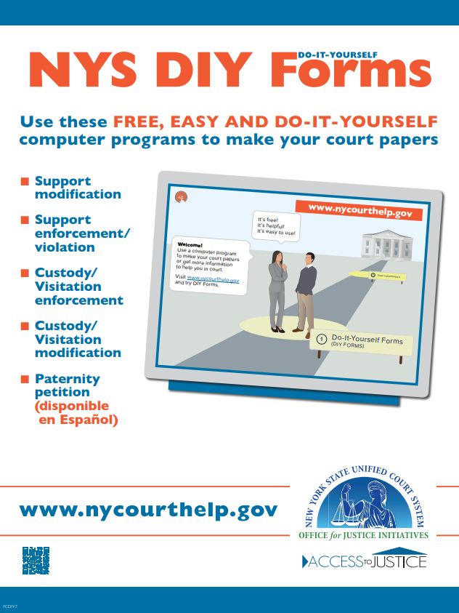
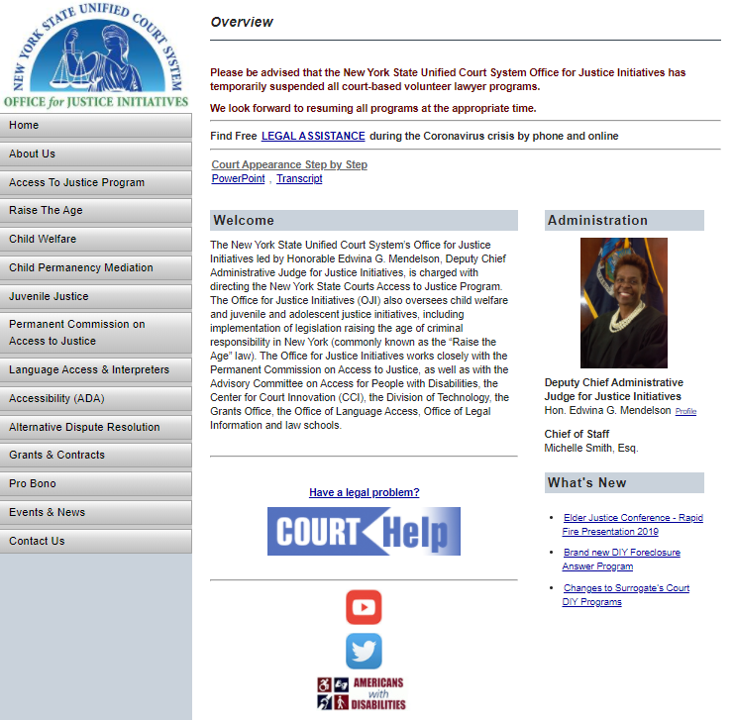
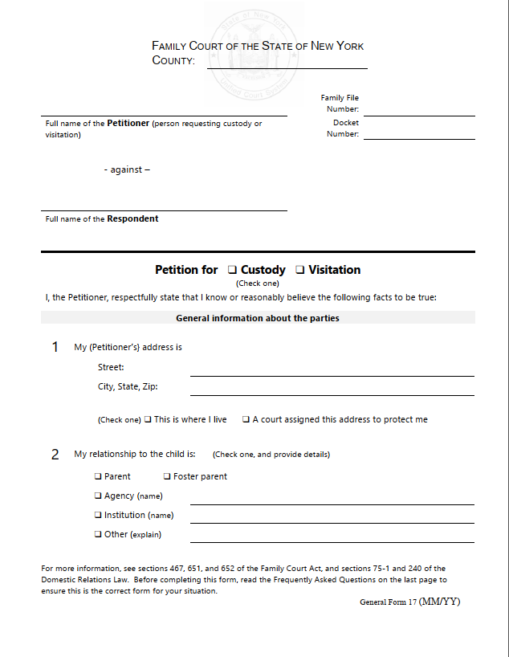
PLAIN LANGUAGE INITIATIVE
The plain language initiative aims to ensure that individuals accessing the court system are provided with clear communications.
makes court documents easier to read.
Court Signage
OJI WEBSITE
Forms
DRAFT
nycourts.gov/OJI

Slide 46
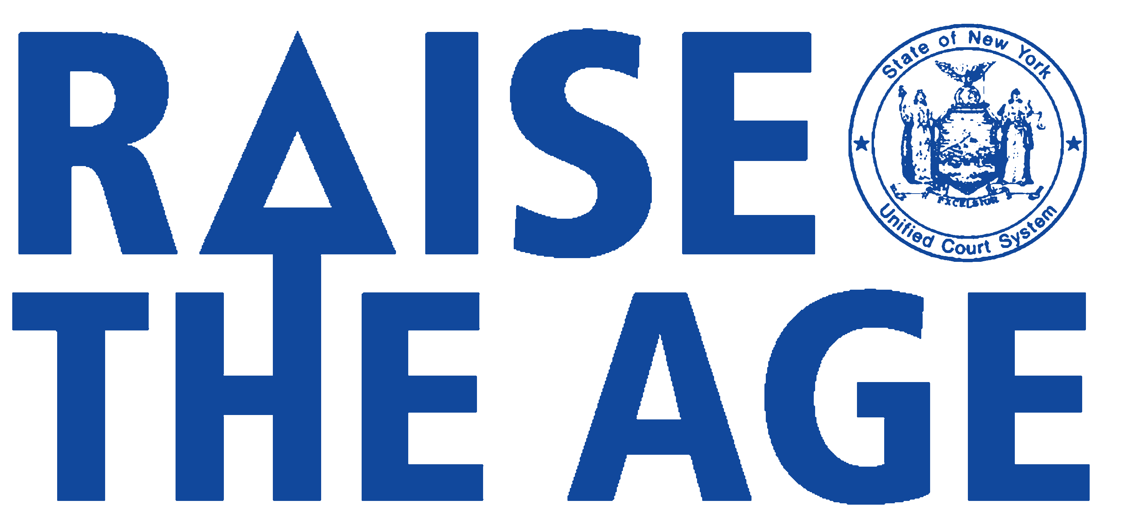
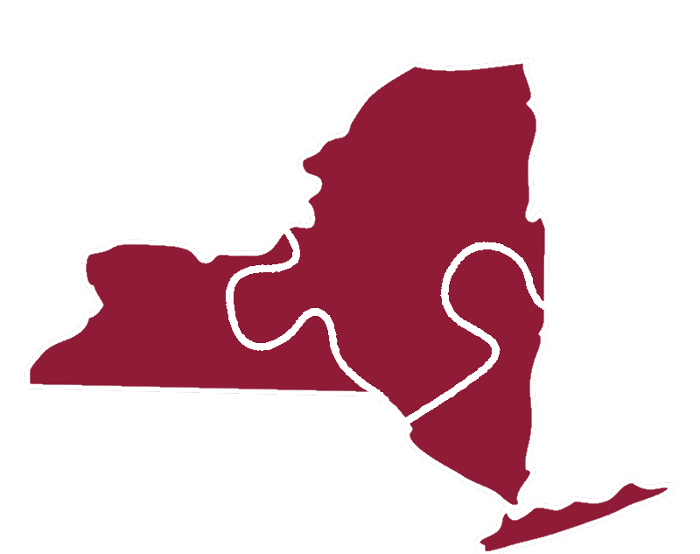

FAMILY & JUVENILE JUSTICE
RAISE THE AGE
CHILD WELFARE
COURT IMPROVEMENT PROJECT
nycourts.gov/OJI

Slide 47

FAMILY & JUVENILE JUSTICE
RAISE THE AGE
COVID-19 Proceedings Guide
Includes information on how to access training for Youth Part judges and Accessible Magistrates, and provides details for handling Adolescent and Juvenile Offender matters, along with relevant COVID-19 related exceptions to RTA case timeframes.
COVID-19 Guide on Preliminary Hearings
  2018
  2019
  October 1
  October 1
  16
  17
  18
CHILD WELFARE
COURT IMPROVEMENT PROJECT
nycourts.gov/OJI

Slide 48
FAMILY & JUVENILE JUSTICE
CHILD WELFARE
RAISE THE AGE
CHILD WELFARE
COURT IMPROVEMENT PROJECT
Stakeholder Convenings
State and local Collaboratives raised awareness of:
  Parenting time for children placed in out-of-home care
  Adoptions pending before the court
  Virtual Permanency Hearings
    No delays beyond federal requirement outside NYC
  Disrupted adoptions due to COVID-19 related deaths
CLE Training Programs
Collaborating for Better Outcomes (substance use)
Interrupting Bias
Engaging Youth in Virtual Permanency Hearings
Indian Child Welfare Act
Roles and Responsibilities
Self-care and Wellness
Aged and Confused (Upcoming January 8th)
Permanency Mediation
Adaptation of Permanency Mediation to a virtual
platform, trainings, and statewide expansion
  CWCIP is a federally funded OJI initiative that works with OCFS to promote the safety, permanence and well-being of abused and neglected children.
Permanency Hearing Project
Permanency Mediation
Lean Management
Statewide System Improvement Program
Integrating Trauma-Informed Practices into Family Court
nycourts.gov/OJI

Slide 49
EMERGING ADULT JUSTICE
New pilot courts in Manhattan and New Rochelle are specifically designed to address the 18 – 25 years old Emerging Adult population.
While most states set the age of criminal responsibility at 18 years old, research shows the brain does not finish fully maturing until the mid-20s. Emerging adults are incarcerated at double their representation in the adult populace.
The Office for Justice Initiatives is committed to support these critical access to justice efforts in criminal justice.

Slide 50
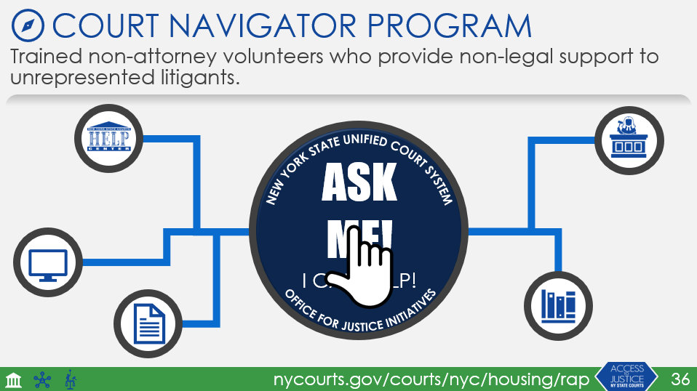
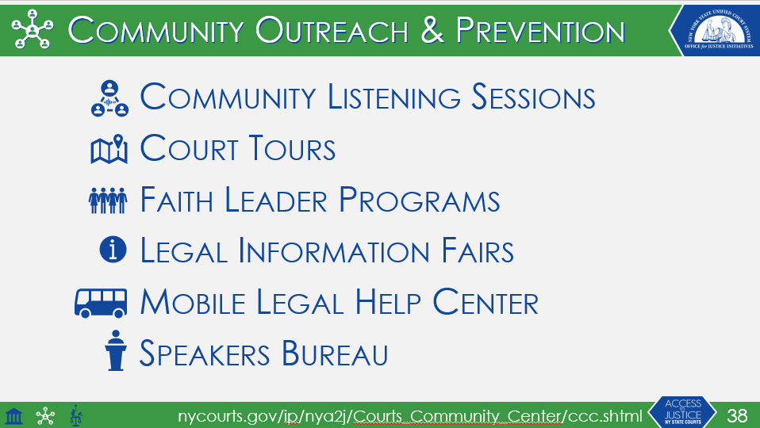
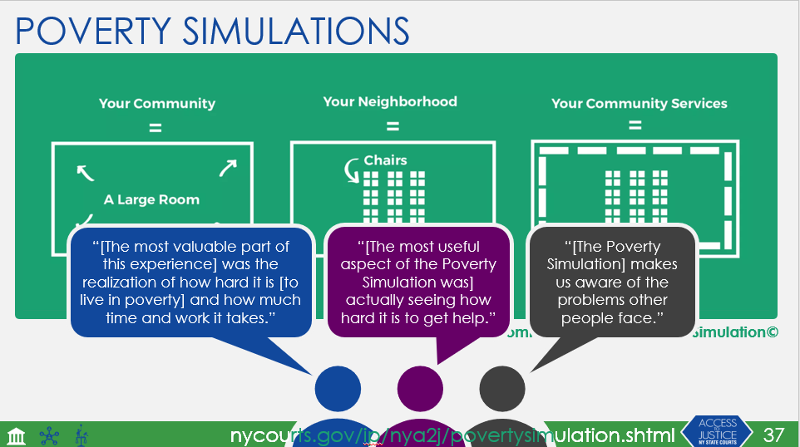
OJI PROGRAMS HEAVILY IMPACTED BY COVID-19
While these programs were impacted by COVID-19, OJI is actively planning their return in virtual formats to better serve court users.
nycourts.gov/OJI

Slide 51
OJI PROGRAM MAP
Court Access
Community Outreach & Prevention
Community Listening Sessions
Court Tours
Faith Leader Programs
Legal Information Fairs
Mobile Legal Help Center
Speakers Bureau
Community Listening Sessions
Court Tours
Faith Leader Programs
Legal Information Fairs
Mobile Legal Help Center
Speakers Bureau
Assistance at the Courthouse
Court Navigators
Court Help Centers
Unbundled Legal Services
Court-Based Pro Bono Programs
Attorney Emeritus Program
Child Welfare & Juvenile Justice Initiatives
Litigants with Diverse Needs
Child Welfare Court Improvement Project
Raise the Age Implementation
Emerging Adult Justice Learning Community
GAL Program
Assigned Counsel Project
Poverty Simulations
OFFICE OF POLICY AND PLANNING
Self-Help Tools
Plain Language Initiative
CourtHelp
DIY Forms
nycourts.gov/OJI

Slide 52

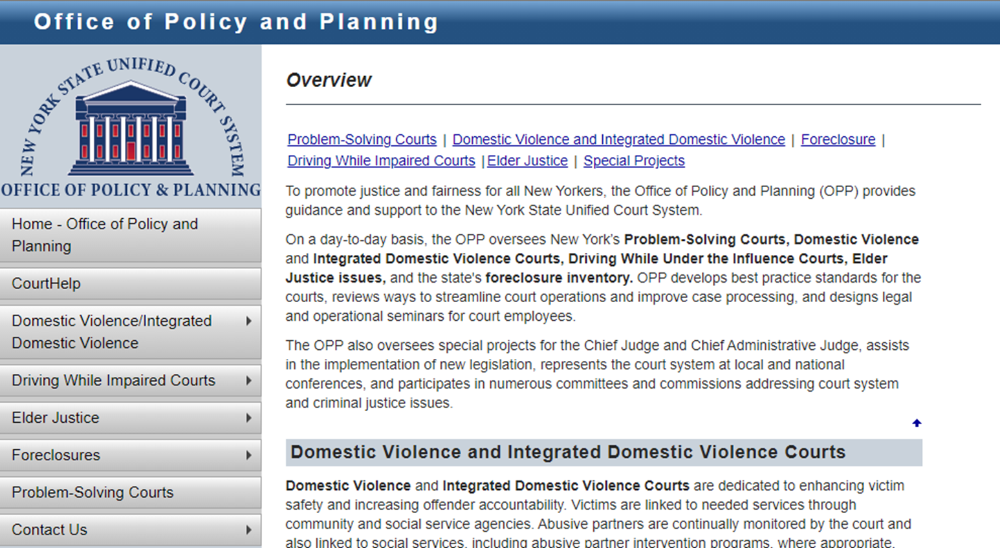
OFFICE OF POLICY AND PLANNING
As of January 1st, Judge Mendelson and OJI assumed oversight of the Office of Policy and Planning (OPP). OPP’s work includes:
Developing best practice standards
Designing legal and operational seminars
Implementing new legislation
Overseeing:
  Problem-Solving Courts
  Domestic Violence and Integrated Domestic Violence Courts
  Driving While Under the Influence Courts
  Elder Justice Issues
  Foreclosure Inventory
  Special Projects
nycourts.gov/admin/opp

Slide 53









LOOKING FORWARD
Expanding Limited Scope Representation
Implementing Bias Awareness & Equity Training
Elder Abuse Detection Tool
PATCH Program
Expansion of Help Centers
UCS Online Dispute Resolution
OJI is available to help you develop Help Centers tailored to the needs of your community
nycourts.gov/OJI |

Slide 54
LOOKING FORWARD
Commission to Reimagine the Future of NYS Courts
Established by Chief Judge DiFiore to provide recommendations regarding in-person and virtual operations and develop a blueprint that courts can use well into the future, the committee is chaired by former State Bar President Hank Greenberg.
  Comprised of lawyers, academics, and technology experts in six working groups: appellate practice; online courts; regulatory innovations; structural innovations; and technology.
nycourts.gov/OJI |

Slide 55
LOOKING FORWARD
Commission to Reimagine the Future of NYS Courts
Established by Chief Judge DiFiore to provide recommendations regarding in-person and virtual operations and develop a blueprint that courts can use well into the future, the committee is chaired by former State Bar President Hank Greenberg.
  Access to Justice related recommendations include:
    Online Dispute Resolution
    Expansion of the Court Navigator Program.
    Use of trained and certified non-lawyer professionals such as social workers to provide limited legal services to unrepresented court users.
nycourts.gov/OJI |

Slide 56

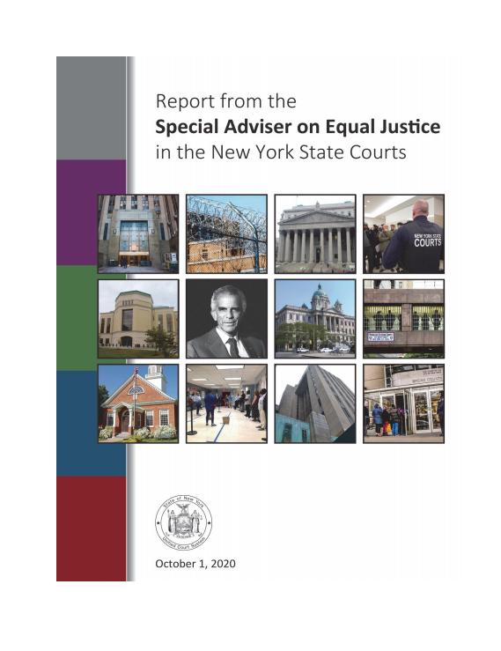
EQUAL JUSTICE IN THE COURTS
In June Chief Judge DiFiore commissioned an independent, in-depth review of the courts’ policies, practices rules, and programs as they relate to issues of racial and other bias. The evaluation was conducted by former U.S. Secretary of Homeland Security Jeh Johnson in his role as Special Adviser on Equal Justice in the Courts. He was assisted by colleagues at Paul, Weiss, Rifkind, Wharton & Garrison, LLP and Baruch College industrial psychologist Professor Harold Goldstein.
Process
Reviewed past reports and ongoing work addressing racial bias in New York State Courts and
Examined demographics of the judiciary
Solicited information and conducted interviews with court staff at all levels and external practitioners
Report Released in October
nycourts.gov/OJI

Slide 57
EQUAL JUSTICE IN THE COURTS
In June Chief Judge DiFiore commissioned an independent, in-depth review of the courts’ policies, practices rules, and programs as they relate to issues of racial and other bias. The evaluation was conducted by former U.S. Secretary of Homeland Security Jeh Johnson in his role as Special Adviser on Equal Justice in the Courts. He was assisted by colleagues at Paul, Weiss, Rifkind, Wharton & Garrison, LLP and Baruch College industrial psychologist Professor Harold Goldstein.
Recommendations Include
Commitment from the top
Mandating bias training
Improving collection and publication of court data
Improving HR practices
Enhancing trust between Court Officers and communities of color
Assignment of an independent monitor to evaluate implementation
nycourts.gov/OJI

Slide 58
EQUAL JUSTICE IN THE COURTS
In June Chief Judge DiFiore commissioned an independent, in-depth review of the courts’ policies, practices rules, and programs as they relate to issues of racial and other bias. The evaluation was conducted by former U.S. Secretary of Homeland Security Jeh Johnson in his role as Special Adviser on Equal Justice in the Courts. He was assisted by colleagues at Paul, Weiss, Rifkind, Wharton & Garrison, LLP and Baruch College industrial psychologist Professor Harold Goldstein.
Implementation
Judge Mendelson was appointed and empowered in October to lead the court’s day-to-day efforts to implement the recommendations.
Working with judicial leaders, court managers, court personnel, and justice system stakeholders across the state to develop detailed plans and timelines
nycourts.gov/OJI

Slide 59
EQUAL JUSTICE IN THE COURTS
In June Chief Judge DiFiore commissioned an independent, in-depth review of the courts’ policies, practices rules, and programs as they relate to issues of racial and other bias. The evaluation was conducted by former U.S. Secretary of Homeland Security Jeh Johnson in his role as Special Adviser on Equal Justice in the Courts. He was assisted by colleagues at Paul, Weiss, Rifkind, Wharton & Garrison, LLP and Baruch College industrial psychologist Professor Harold Goldstein.
Implementation Partners
Counsel’s Office
Department of Public Safety
Division of Professional and Court Services
Division of Technology and Court Research
Division of Human Resources
Franklin H. Williams Judicial Commission
Judicial Institute
Office of Diversity and Inclusion
Office for Justice Initiatives
Office of the Managing Inspector General for Bias Matters
Workforce Analysis Office
nycourts.gov/OJI

Slide 60
LOOKING FORWARD
Our Part
Your Part
Developing Programs
Communicating Information
Providing Support
Troubleshooting
Research
Keep us in mind, we’re here to help!
Identify areas of need
Bring them to our attention.
If you have questions, ask!
nycourts.gov/OJI |

Slide 61
MAJOR PARTNERS
ADR Advisory Committee | Jewish Association for Services for the Aged
Advisory Committee on Access for People with Disabilities | Judicial Institute
Advisory Committee on Parental Representation | New York Area Law Schools
Advisory Council on Immigration Issues in Family Court | NYC Human Resources Administration
All NYS Unified Court System Commissions, most notably: | New York State Division of Criminal Justice Services
Judicial Committee on Women in the Courts | New York State Office of Children and Family Services
Permanent Commission on Access to Justice | NYC Department of Aging
Permanent Commission on Justice for Children | NYLAG Mobile Legal Help Center
Racial and Ethnic Fairness, Franklin H. Williams Judicial Commission | NYS Unified Court System, Division of Professional and Court Services Grants and Contracts
The Richard C. Failla LGBT Commission | NYS Unified Court System, Division of Technology
Attorney Emeritus Program Advisory Committee | NYS Unified Court System, Human Resources’ Workforce Analysis Office
Center for Law and Elder Justice
Counsel’s Office | NYS Unified Court System, Office of Language Access
Department of Public Safety | Office of Diversity and Inclusion
Division of Professional and Court Services | Office of the Managing Inspector General for Bias Matters
Division of Technology and Court Research | Office of Public Affairs
Division of Human Resources | State, local, and affinity bar and judicial associations
Family Court Advisory and Rules Committee | The Center for Court Innovation
Family Violence Task Force | The Harry and Jeanette Weinberg Center for Elder Justice
Feerick Center for Social Justice
nycourts.gov/OJI |

Slide 62
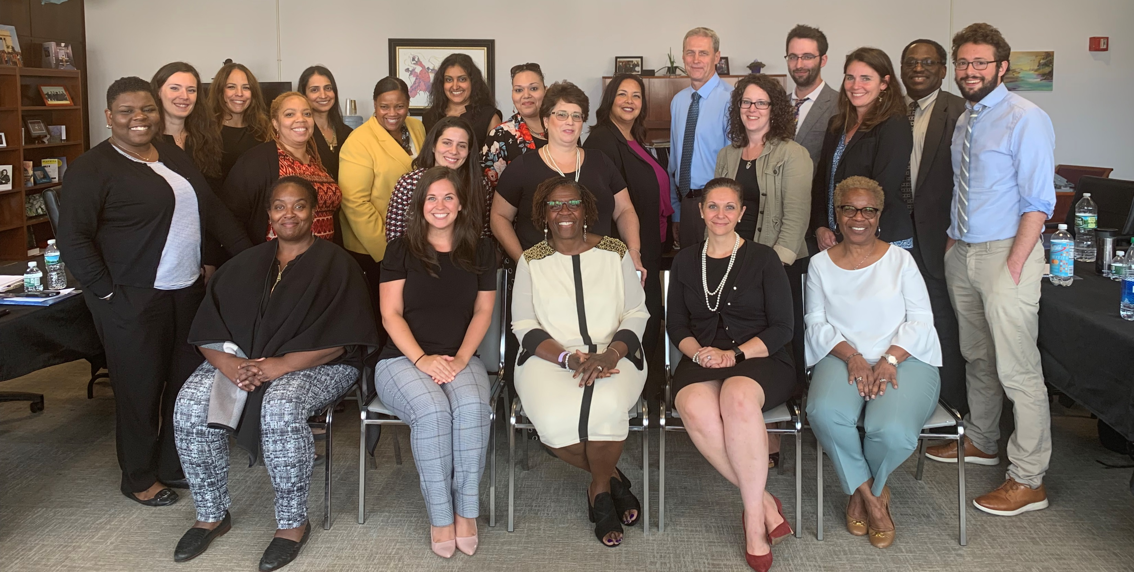
The Office for Justice Initiatives
Contact Information:
(646) 386-3200
dcaj-oji@nycourts.gov
Mailing Address:
The Office for Justice Initiatives
111 Centre Street
New York, NY 10013
RESOURCES
OJI Website|nycourts.gov/OJI
Access to Justice Website|nycourts.gov/ip/nya2j
DIY Website|nycourts.gov/courthelp/DIY
CourtHelp|nycourts.gov/courthelp
Publications|nycourts.gov/ip/nya2j/publications.shtml

